Slide 1
GOAL2GRADE
CAPSTONE PROJECT
Presented By:
DARSHIL DETROJA
MARWADI UNIVERSITY
COMPUTER ENGINEERING
AICTE STUDENT ID : STU681f03bc319171746863036

Slide 2
OUTLINE
Problem Statement
System Development Approach (Technology Used)
Algorithm & Deployment (Step by Step Procedure)
Result
Conclusion
Future scope
References

Slide 3
Problem Statement
Students often face challenges in organizing study schedules and tracking academic tasks.
This planner helps users create, view, and manage study goals with reminders and visual timelines
The goal is to boost productivity and time management.
Tasks and progress can be saved locally.

Slide 4
System Approach
Frontend Technologies:
HTML5 - Semantic markup structure
CSS3 - Modern styling with animations and responsive design
Bootstrap 5 - Responsive framework and UI components
JavaScript (ES6+) - Interactive functionality and data management
Font Awesome - Icons and visual elements
Local Storage API - Data persistence

Slide 5
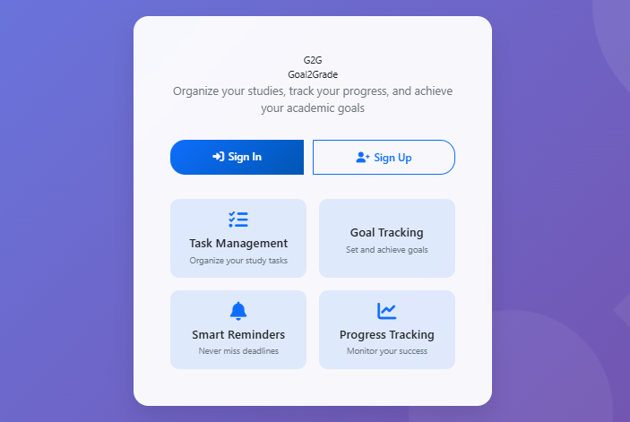
System Approach – Design
Glass-morphism UI
Scrollable animated background images
Responsive layout for all devices
Smooth animations and transitions

Slide 6
Algorithm & Deployment
User Authentication
Signup & Login system with form validation
Password strength validation and session management
Demo account support for quick access
Task Management
Create, edit, and delete study tasks
Assign due date, subject, and priority
Mark tasks as completed and filter by status
Goal Tracking
Define study goals with target dates
Track progress with visual progress bars
Update progress manually (+ / – controls)

Slide 7
Algorithm & Deployment
Reminders
Set custom reminders with date & time
Show visual notifications with auto-dismiss
Manage reminders in dashboard
Dashboard & Timeline
Display today’s tasks and upcoming deadlines
Show study statistics and progress charts
Timeline view for chronological task/goal tracking

Slide 8
Algorithm & Deployment
Testing
Cross-browser compatibility (Chrome, Firefox, Safari, Edge)
Mobile responsiveness for different screen sizes
Offline persistence with local storage
Deployment
Runs completely in browser (no backend required)
Files: landing.html, login.html, signup.html, index.html, styles.css, script.js
Host using GitHub Pages / Netlify for free access
Supports offline use via browser local storage

Slide 9
Algorithm & Deployment - Workflow
User authentication
Dashboard visualization
Task/goal creation
Reminder setup
Timeline View
About page
Contact page
Local storage updates

Slide 10
USER AUTHENTICATION
- Secure signup and login system
- User profile management
- Session management with remember me option
- Password strength validation
- Form validation and error handling

Slide 11
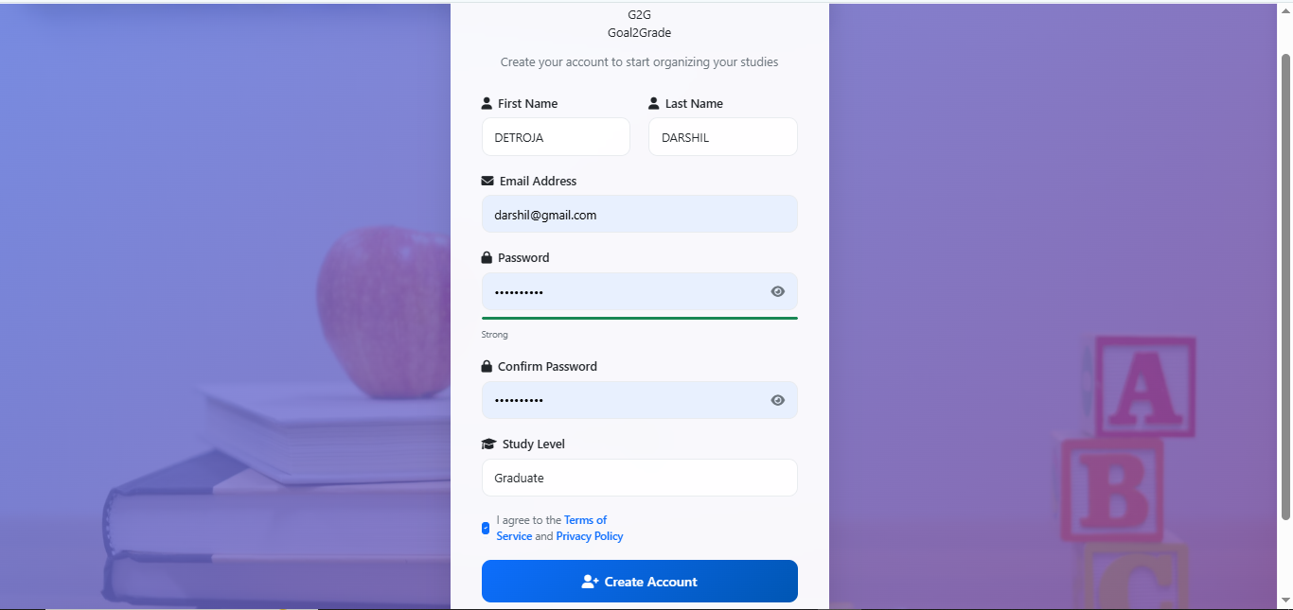
SIGN UP PAGE

Slide 12
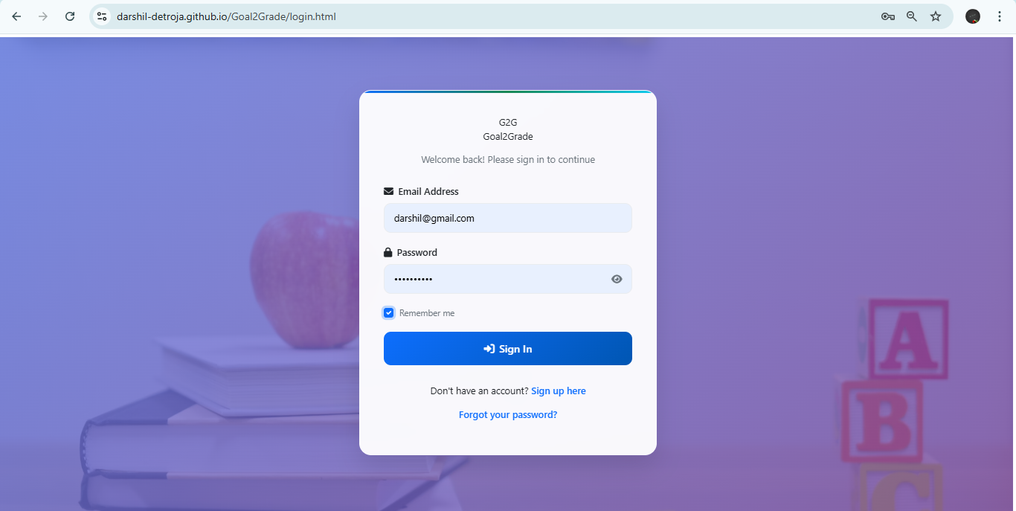
SIGN IN PAGE

Slide 13
DASHBOARD VISUALIZATION
- Overview of today's tasks
- Upcoming deadlines
- Study statistics and progress tracking
- Visual progress indicators
- User-specific data display
- Daily change Motivational quotes

Slide 14
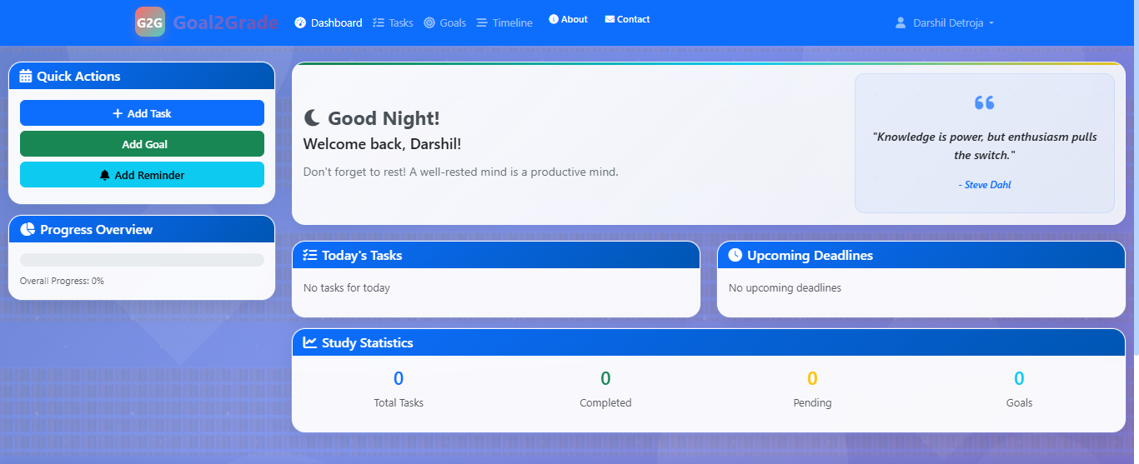
DASHBOARD PAGE

Slide 15
TASK CREATION
- Create, edit, and delete study tasks
- Set due dates, priorities, and subjects
- Mark tasks as completed
- Filter tasks by status (All, Pending, Completed)
- Visual priority indicators

Slide 16
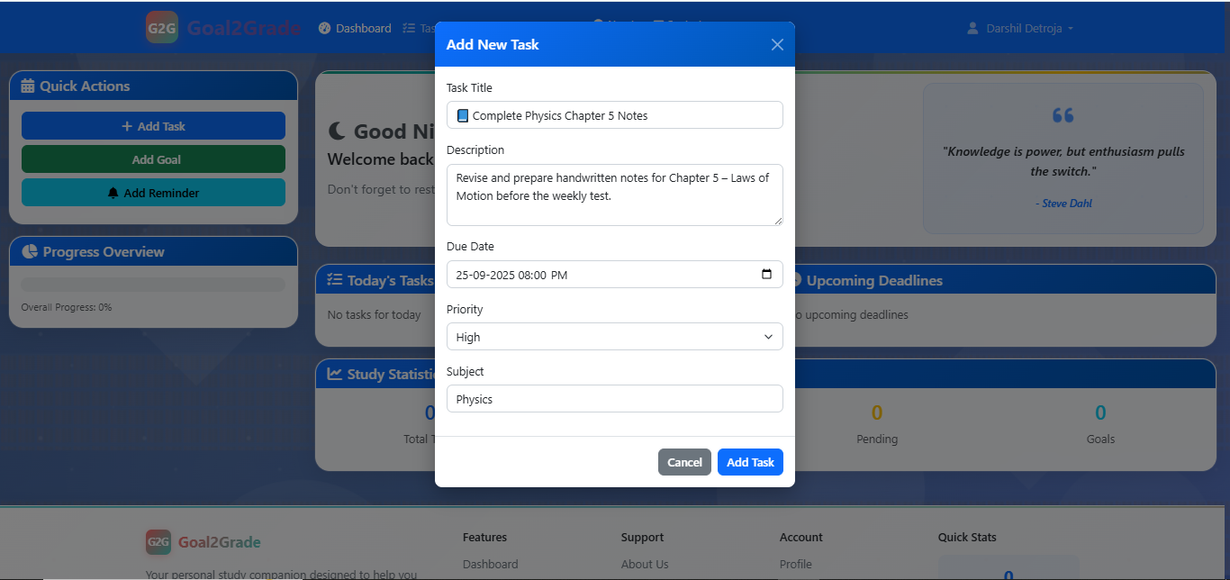
ADD NEW TASK

Slide 17
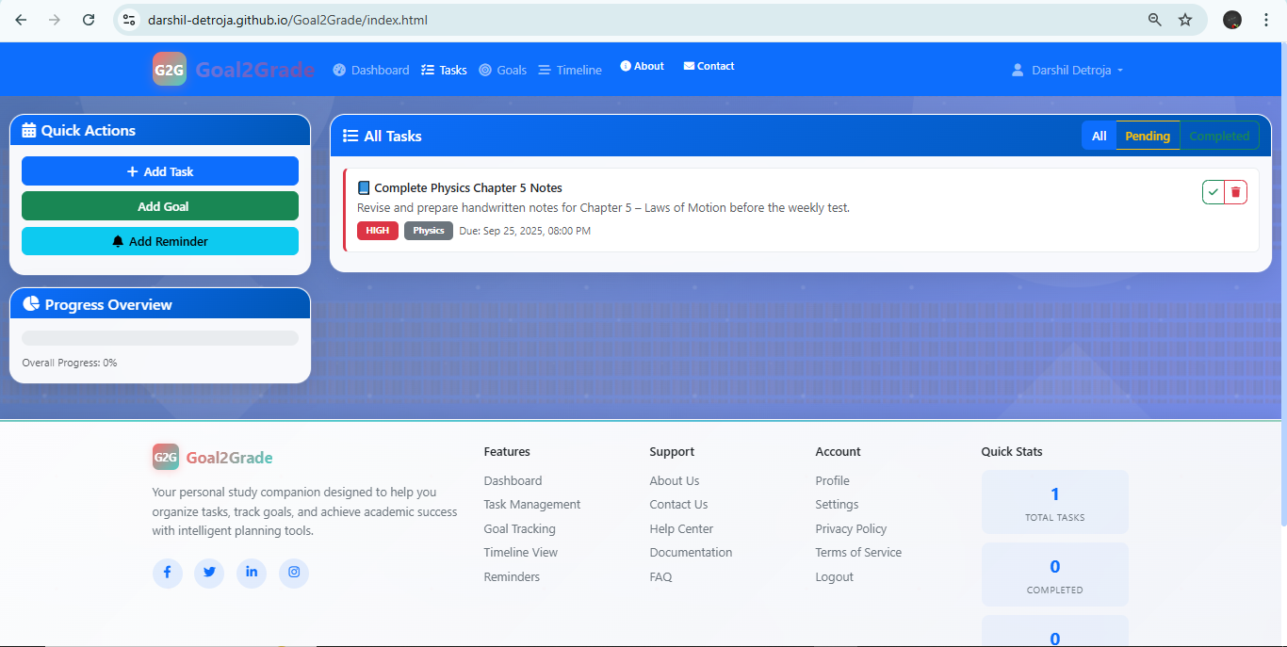
Task page

Slide 18
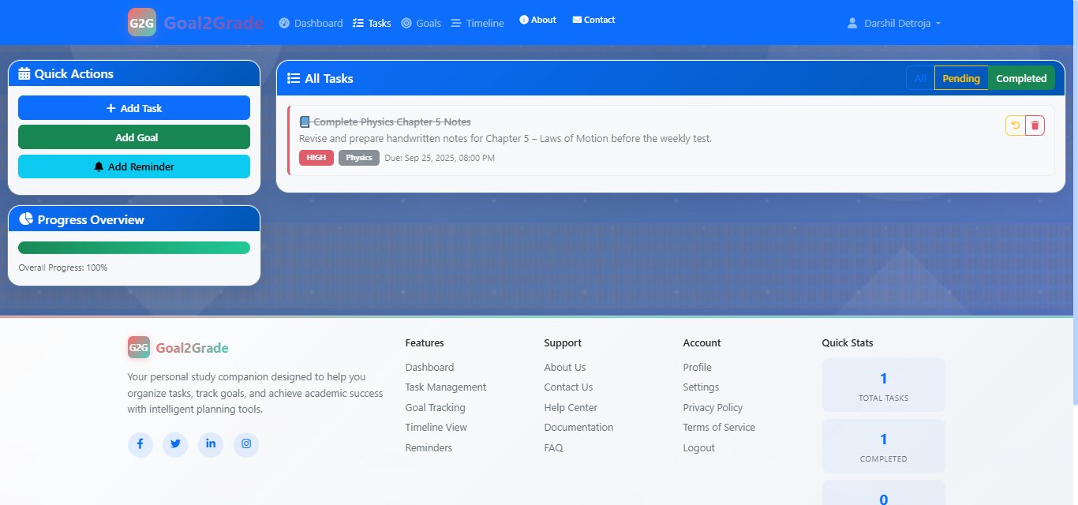
Task page

Slide 19
GOAL CREATION
- Set and track study goals
- Monitor progress with visual progress bars
- Set target dates for goals
- Update progress manually

Slide 20
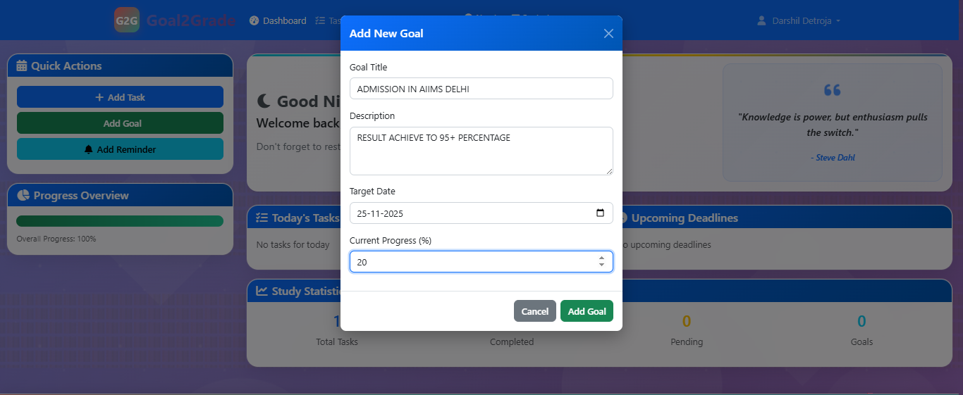
ADD GOAL

Slide 21
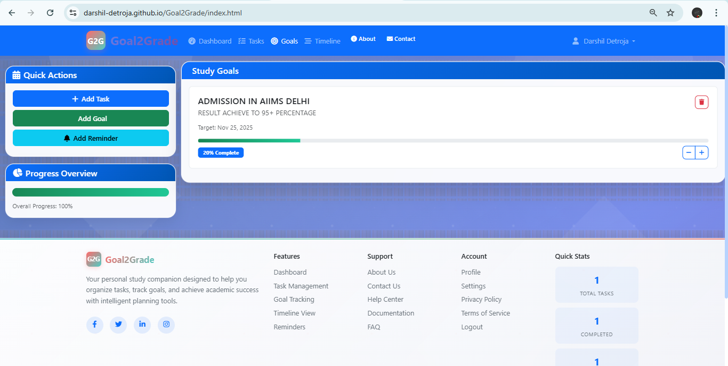
GOAL PAGE

Slide 22
REMINDER SETUP
- Set custom reminders for important deadlines
- Visual notifications with auto-dismiss
- Reminder management system

Slide 23
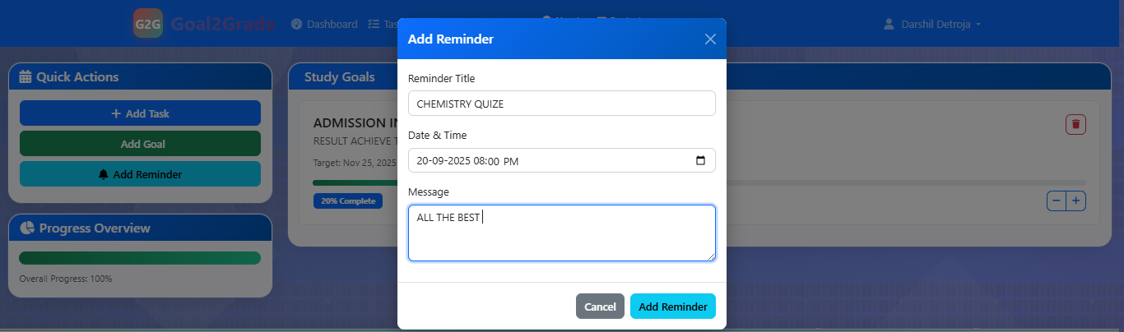
REMINDER PAGE

Slide 24
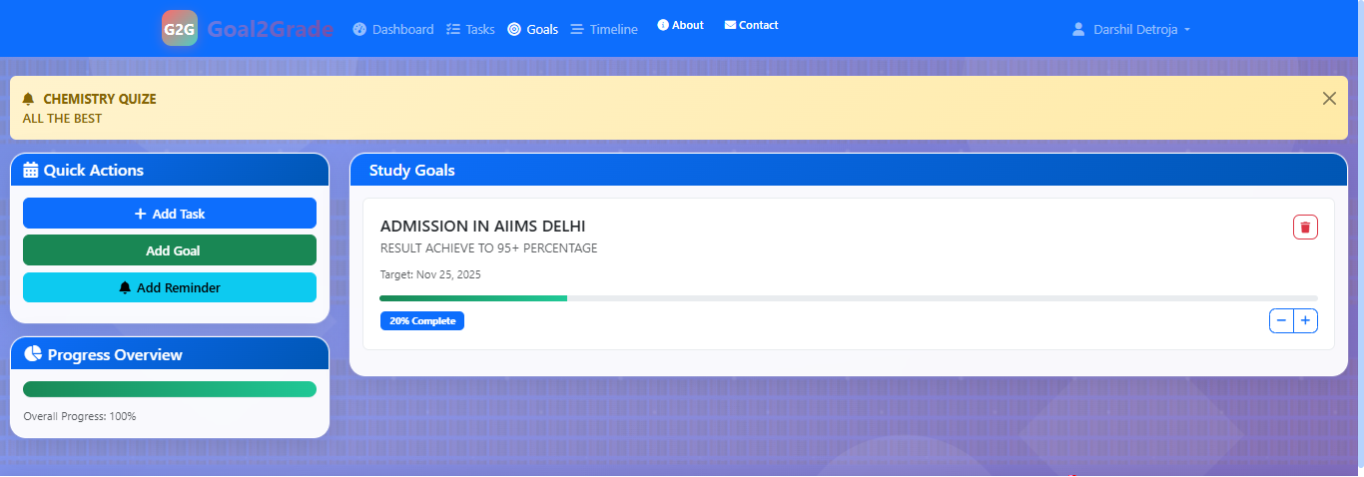
REMINDER view

Slide 25
TIME LINE VIEW
- Chronological view of all tasks and goals
- Visual timeline with status indicators
- Easy identification of overdue items

Slide 26
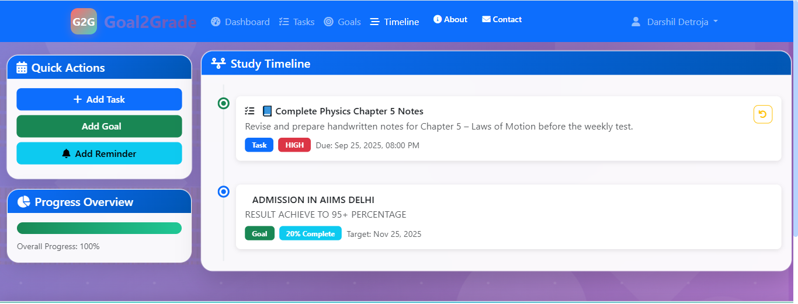
TIMELINE PAGE

Slide 27
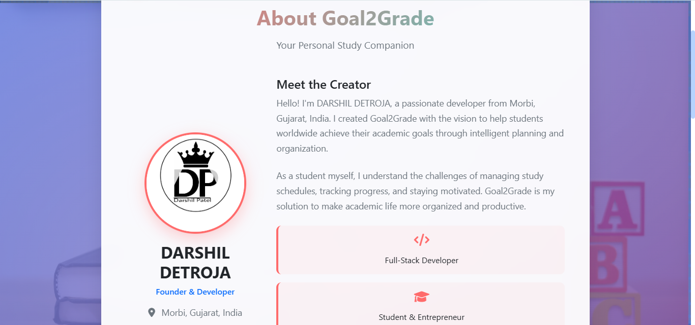
ABOUT PAGE

Slide 28
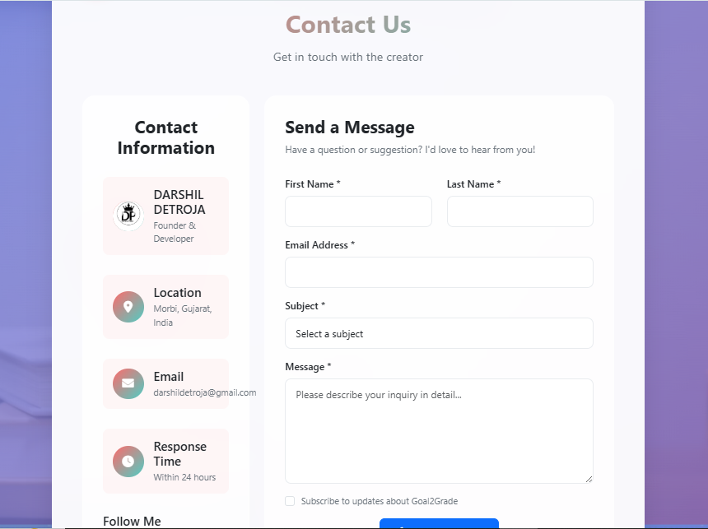
CONTACT US PAGE

Slide 29
LOCAL STORAGE
- All data is saved locally in your browser
- User-specific data isolation
- No external dependencies or accounts required
- Data persists between sessions

Slide 30
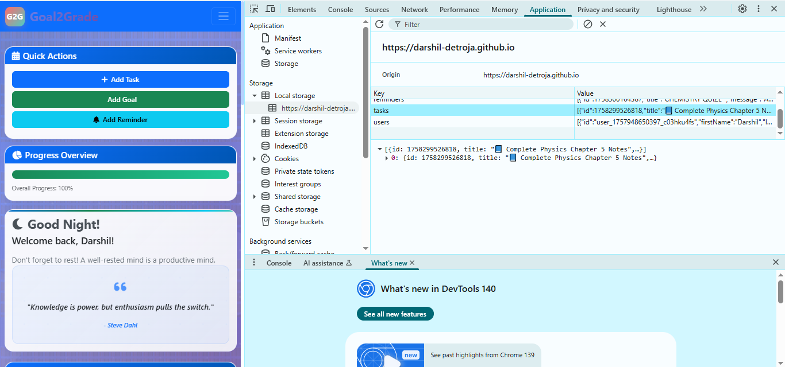
LoCAL STORAGE

Slide 31
MODERN UI/UX
- Scrollable animated background images
- Glass-morphism design with backdrop blur
- Responsive design for all devices
- Smooth animations and transitions
- Modern color scheme and typography

Slide 32
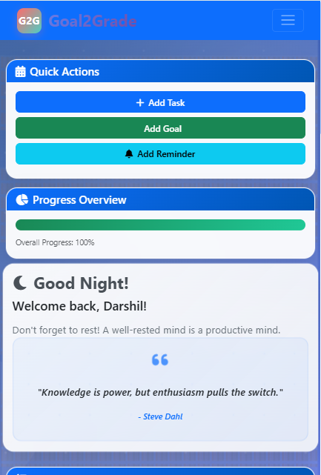
RESPONSIVE

Slide 33
Result
Github Code Link :
https://github.com/Darshil-Detroja/Goal2Grade.git
Github Deployment Link :
https://darshil-detroja.github.io/Goal2Grade/

Slide 34
Conclusion
Smart Study Planner provides a simple yet powerful way for students to manage studies
Combines task management, goals, reminders, and progress visualization
Helps students stay motivated and organized

Slide 35
Future scope
Export/import data
Theme customization
Study session timers
Grade tracking
Mobile app version

Slide 36
References
Bootstrap CSS
https://cdn.jsdelivr.net/npm/bootstrap@5.3.0/dist/css/bootstrap.min.css
Font Awesome CSS
https://cdnjs.cloudflare.com/ajax/libs/font-awesome/6.0.0/css/all.min.css
Bootstrap JS (Bundle)
https://cdn.jsdelivr.net/npm/bootstrap@5.3.0/dist/js/bootstrap.bundle.min.js
Unsplash Image (Background)
https://images.unsplash.com/photo-1503676260728-1c00da094a0b?ixlib=rb-4.0.3&auto=format&fit=crop&w=2070&q=80

Slide 37
THANK YOU Any question ?
CONTACT : darshildetroja@gmail.com

